Slide 1
Buffet Restaurant Software ENGEENERING
Jose Ignacio valladares ibarra
Theodoros kyriazis
Safak yildiz

Slide 2
Objectives
Describe a good system for ordering food in the restaurant
Explain the relation of actors and the system

Slide 3
Requirements

Slide 4
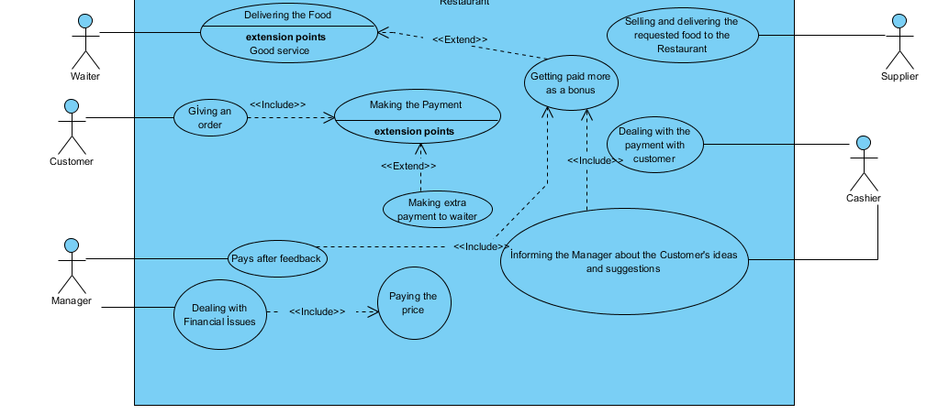
Use case scenario

Slide 5
ACTIVITY DIAGRAM

Slide 6
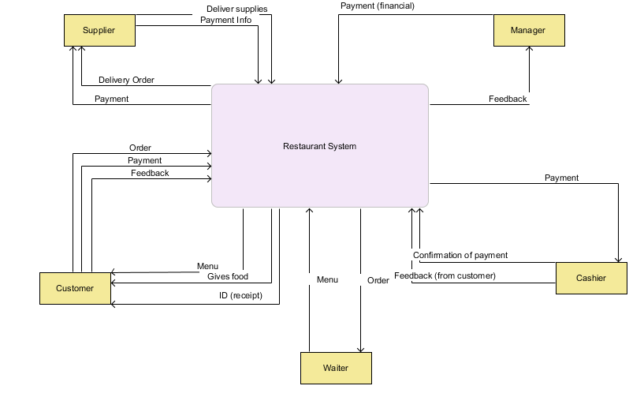
DFD (Level 0)

Slide 7
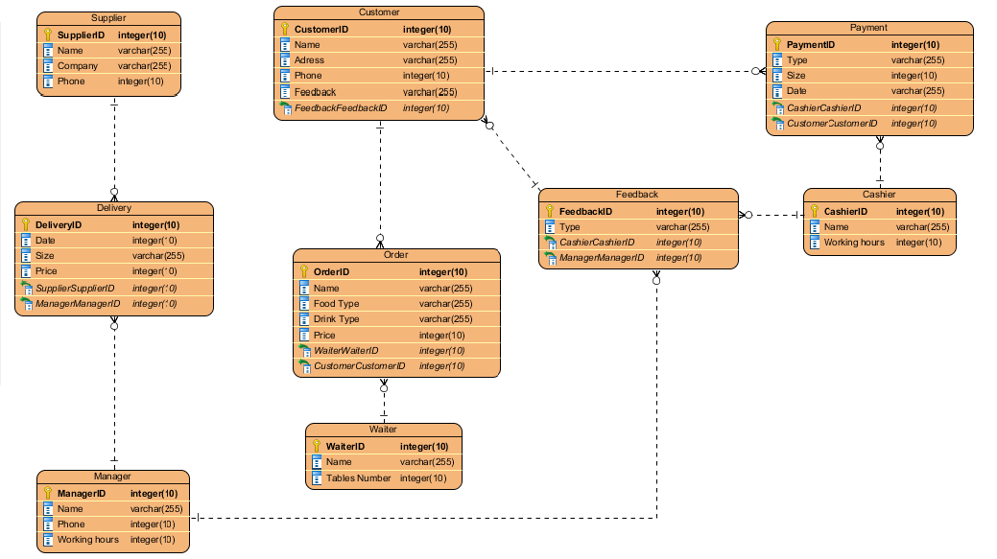
ERD

Slide 8
CONCLUSIONS
We basically created a system where you can order food and get this food delivered to you inside the restaurant.

